Slide 1




Market Organization in Lebanese Microgrids: Insights from Electricity Demand Elasticity and Game-Theory Optimization
Sebastian Zwickl-Bernhard^{1,2}, Anne Neumann^{2,3}, Majd Olleik^{4,} Haytham Dbouk⁵
¹Energy Economics Group (EEG), Technische Universität Wien, Gußhausstraße 25-29/E370-3, 1040 Wien, Austria
²Department of Industrial Economics and Technology Management, The Norwegian University of Science and Technology (NTNU), Sentralbygg 1, 946, Gløshaugen, Trondheim, Norway
³Norwegian School of Economics (NHH), Helleveien 30, 5045 Bergen, Norway
⁴Department of Industrial Engineering and Management (IEM), American University of Beirut, Lebanon
⁵Innovating Green Technology (IGT), Chiyaha, Cheikh Taleb Khalil, Beirut, Lebanon
Internal Meeting / 13 March 2025
Contact: zwickl@eeg.tuwien.ac.at

Slide 2
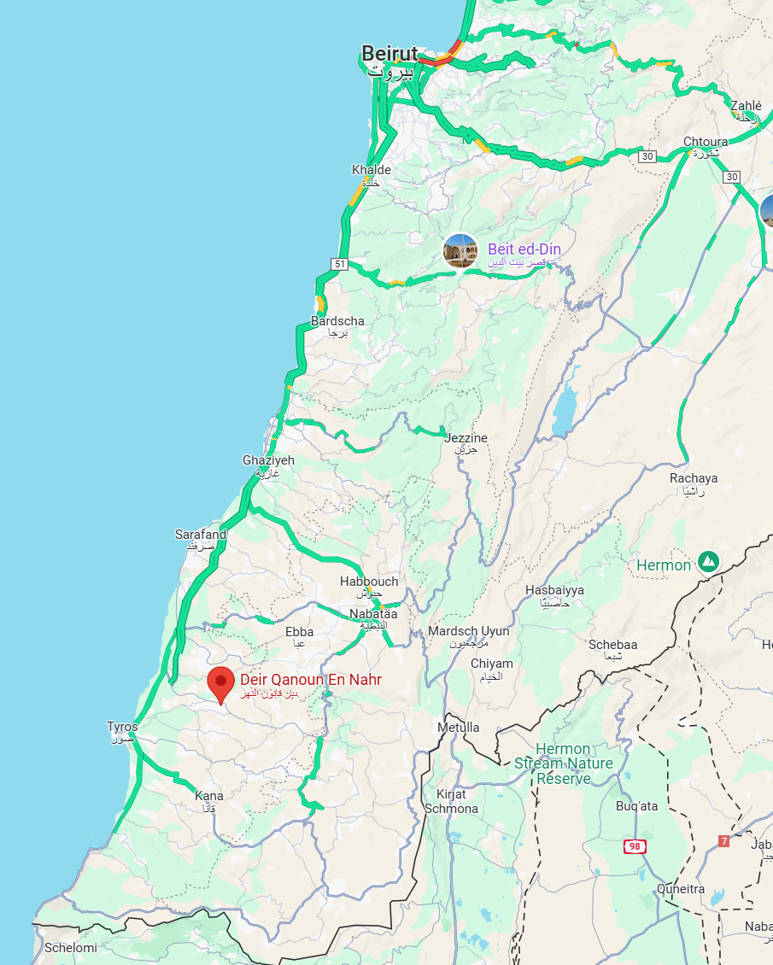
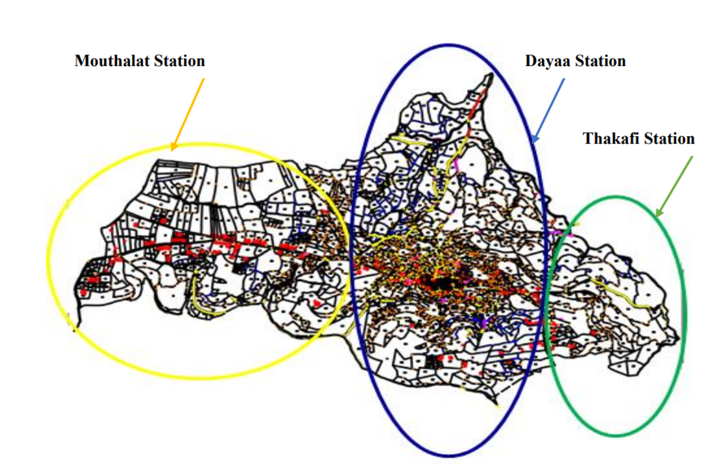
Energy Situation in Deir Kanoun
15,000 inhabitants with 1150 households and 194 commercial/industrial units
Three micro grids (Mouthalat, Dayaa, and Thakafi)

Slide 3
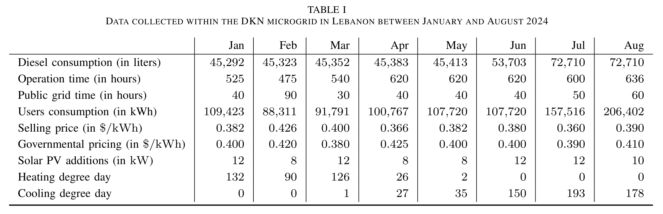
Collected data of the Lebanese microgrid in Deir Kanoun al Naher

Slide 4
Recap: demand elasticity in the proposal (2 of 2)
Once the price elasticity of demand of each type is estimated and demand functions with respect to the price are derived, Models 1 and 2 will be made use of through an iterative approach as follows:
Set the demand levels of the various market players to their base case levels as surveyed or reported in the most recent data
Run Models 1 and 2 based on the defined demand levels.
Compute the resulting electricity price.
Determine the new demand levels of market players using the resulting electricity price and the derived demand functions.
Verify if the new demand levels are similar to the defined demand levels used in Step 2. If Yes, the algorithm has converged and the solution is reached. If No, go to Step 2 using the new demand levels.

Slide 5
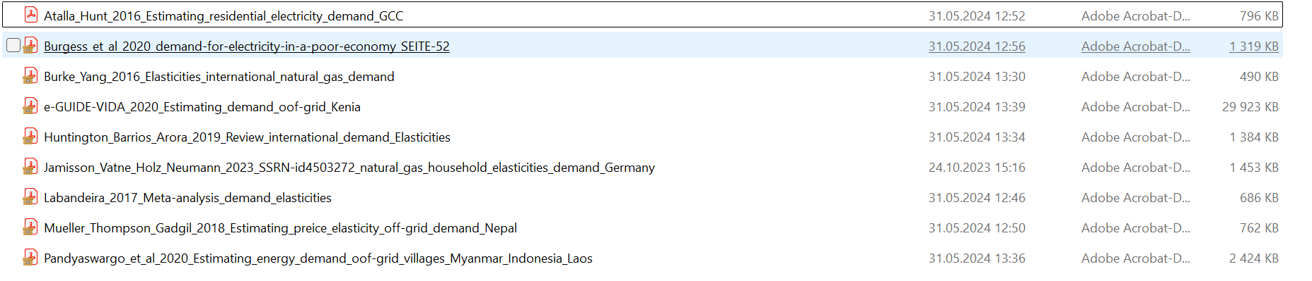
What has happened so far…
Started with thorough literature review (Sebastian & Anne)
Dicussion on the applied methodology (will build on Ruhnau et al. (2022)¹)
“We use an econometric model to identifiy…”
“Model parameters are estimated with an ordinary least squares estimator using heteroscedasticity and autocorrelation robust standard errors.”
For household consumers, we will use the historical monthly bills of diesel generator subscribers.
To be decided: how we include the impact of inflation on the demand elasticity
¹10.1038/s41560-023-01260-5

Slide 6
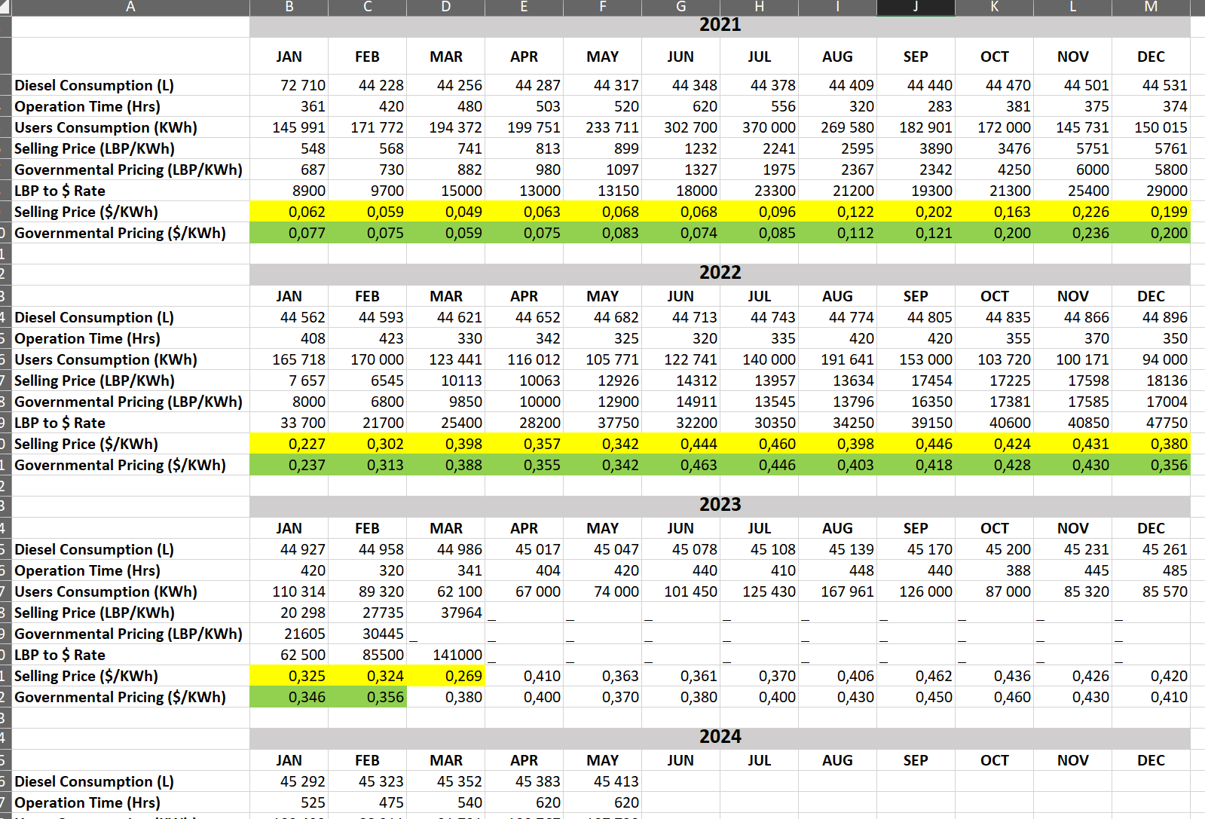
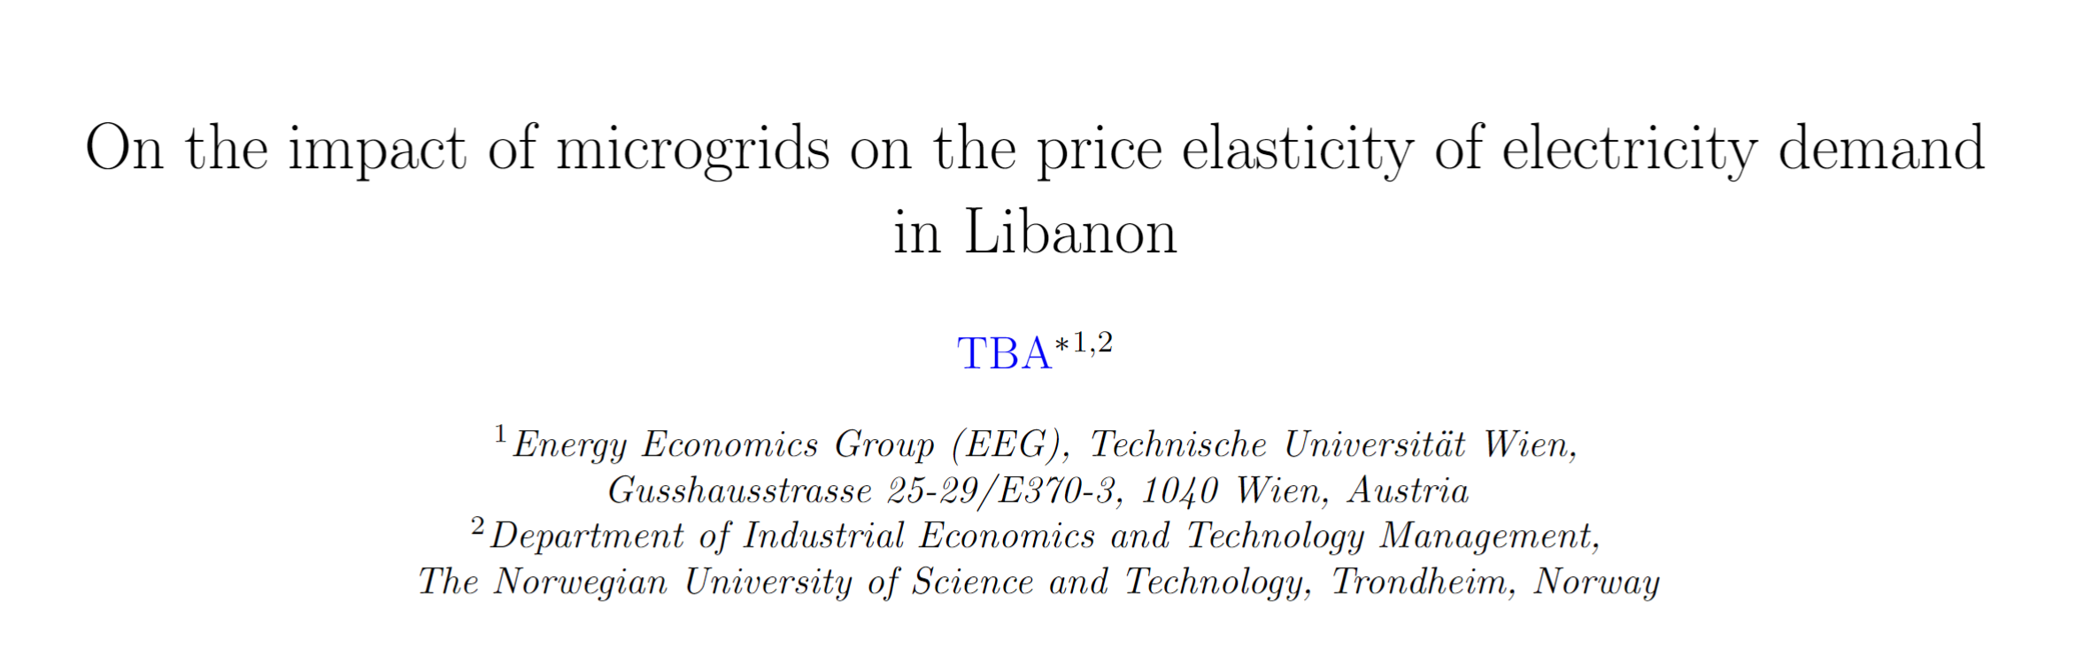
DE of Household consumers is de facto available already
Measured values
Could be relatively soon incorporated in the models 1 and 2
However,…
➔ Households consumer vs. Household prosumers

Slide 7
Next steps
Focus on working on the publication (submission by end of the year)
Therefore, soonish decide on the main focus
(A) Focus only on identifying household consumers demand elasticity
(B) Focus on the comparison, then the question is how we get and when we have the values for household prosumers…?
As close as possible to the available data that we have…
Have you changed your behavior?
Literature available regarding “from survey” to elasticities?

